Slide 1

Rhode Island Home Repair Program
Providence Revolving Fund
SPECIAL LEGISLATIVE COMMISSION TO STUDY AND PROVIDE RECOMMENDATIONS FOR THE CREATION OF A STATEWIDE WHOLE-HOME REPAIRS PROGRAM/ October 6, 2025

Slide 2
Providence Revolving Fund Home Repair Programs
PRF’s Neighborhood Loan Fund is composed of restricted funds and PRF assets. This is PRF’s longest standing program. The program offers loans up to $50,000 for exterior repair/renovation/preservation.
In this program, borrowers are provided with construction management where a skilled professional provides detailed plans, specifications, and construction monitoring.
March 2023, PRF was named the successful bidder on a RFP to assist in creating and administering a loan program. The Providence Department of Inspection and Standards(DIS) referred Providence homeowners to make repairs and take corrective action, as needed. Due to the success of this program, the Providence City Council passed an ordinance adding $3 million of City of Providence ARPA funds.
In February 2024, PRF was selected as the winning bidder for the $4.5 million State of Rhode Island Home Repair Program. In July 2024, we began taking applications for the State Program. We have been running all programs concurrently.

Slide 3

Homeowner Interest in Home Repair Assistance
Interest in these programs from 959 homeowners
  402 of these submitted their information after both ARPA programs were wait-listing new apps
  345 properties are outside of QCTs or Providence
    Most were from East Providence (57). Pawtucket (53), Woonsocket (39), Cranston (32), Warwick (24), West Warwick (23)
  PRF will alert all previously-interested applicants to new home repair programs

Slide 4
Referral Sources (Self Reported)

Slide 5
Where we are now
Post-Intake, Pre-Closing: 36 properties with 67 units
Closed, In Construction: 33 properties with 62 units
Completed: 52 properties with 82 units
As more projects complete under their entitled $50,000 or $75,000, properties are brought off the waitlists

Slide 6
The Process
Intake application is received though the online portal
Full Intake
Prescreen eligible
Income is not eligible
Title Search
Property Inspection
PRF Staff contacts the applicant with alternative solutions
Project Completed
Title/Ownership issues
Insurance
Bidding
Loan Closing
Project in construction

Slide 7
Intake – Eligibility Screening
Intake portal is hosted on Jotform – phone call or paper applications are also available
Asks about participation in or applications to other programs – can expedite income qualification and maximize funding
Those outside of program areas were immediately told that their property was not eligible, but that PRF could notify them of future programs
Addresses are sent to Census Geocoder tool upon submission to check for QCT (if required by the program)
Properties are sorted by geographic eligibility and populate our project management system to begin income qualification
For managing follow-ups, project management system has phone integrations

Slide 8
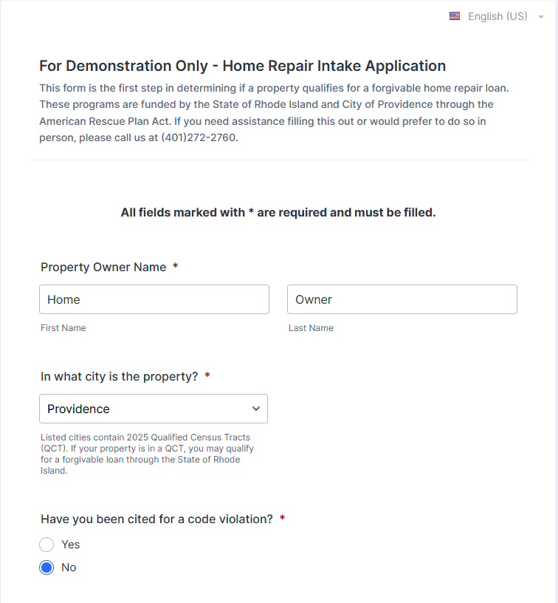
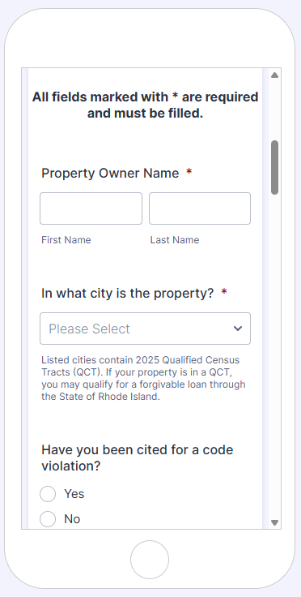
Intake Portal
Can be further adapted to screen
for additional eligibility
Link to Demo Form
Mobile View
Demo Video

Slide 9
Income and Property Qualification
PRF collects and reviews income documentation
  Some factors can be used to flag potential eligibility for other programs.
  Ex. mobility disabilities, children with asthma
Homeowner is alerted to result, and if eligible, a title report is requested
  For Providence program, PRF first visited properties to ensure that violations were present before City performed a title search
  Some title issues are non-disqualifying, and PRF works with applicants to update required documentation
PRF confirms homeowner’s repair needs, then schedules a Cost Estimate visit

Slide 10
Construction Management
Cost Estimate is reviewed with homeowner to confirm priorities
PRF schedules a site visit during which contractors can inspect and create their bids
Contractor Database – Open RFQ for licensed and insured contractors. Must include references.
  Currently 46 contractor firms
  System is set up to request updated licenses and insurance from contractors and alert PRF to lapsed coverage
Vetted contractors are notified of upcoming walkthroughs for bidding
Once repair work begins, PRF Construction Managers visit job sites, checking compliance with regulations, standards, and specifications

Slide 11

Loan Forgiveness
20% of full loan value is forgiven each year for 5 years
Lien is placed on property
Sale or foreclosure of a property pays remaining loan balance out of sale proceeds

Slide 12
Program Participants
Mean and Median homeowner age of 55
Most in Providence, Woonsocket, East Providence, Central Falls
Data as of 10/3/25

